Slide 1
Classification and Prediction ——Classification by Decision Tree——
徐华
清华大学 计算机系 智能技术与系统国家重点实验室
xuhua@tsinghua.edu.cn

Slide 2
Classification and Prediction
Basic Concepts
Issues Regarding Classification and Prediction
Decision Tree
Bayesian Classification
Neural Networks
Support Vector Machine
K-Nearest Neighbor
Associative classification
Classification Accuracy

Slide 3
Training Dataset
This follows an example from Quinlan’s ID3

Slide 4
Training Dataset
age | income | student | credit_rating | buys_computer
<=30 | high | no | fair | no
<=30 | high | no | excellent | no
<=30 | medium | no | fair | no
<=30 | low | yes | fair | yes
<=30 | medium | yes | excellent | yes
>40 | medium | no | fair | yes
>40 | low | yes | fair | yes
>40 | low | yes | excellent | no
>40 | medium | yes | fair | yes
>40 | medium | no | excellent | no
31…40 | high | no | fair | yes
31…40 | low | yes | excellent | yes
31…40 | medium | no | excellent | yes
31…40 | high | yes | fair | yes

Slide 5
Output: A Decision Tree for “buys_computer”
age?
<=30
overcast
>40
30..40
student?
yes
credit rating?
no
yes
excellent
fair
no
yes
no
yes

Slide 6
Algorithm for Decision Tree Induction
Basic algorithm (a greedy algorithm)
Tree is constructed in a top-down recursive divide-and-conquer manner
At start, all the training examples are at the root
Attributes are categorical (if continuous-valued, they are discretized in advance)
Examples are partitioned recursively based on selected attributes
Test attributes are selected on the basis of a heuristic or statistical measure (e.g., information gain)
Conditions for stopping partitioning
All samples for a given node belong to the same class
There are no remaining attributes for further partitioning – majority voting is employed for classifying the leaf
There are no samples left

Slide 7
Attribute Selection Measure: Information Gain (ID3/C4.5)
Select the attribute with the highest information gain(信息增益)
S contains si tuples of class Ci for i = {1, …, m}
information measures info required to classify any arbitrary tuple
Entropy（熵） of attribute A with values {a1,a2,…,av}
information gained（信息增益） by branching on attribute A

Slide 8
Attribute Selection: Information Gain
Class P: buys_computer = “yes”
Class N: buys_computer = “no”
I(p, n) = I(9, 5) =0.940
Compute the entropy for age:
means “age <=30” has 5 out of 14 samples, with 2 yes’es and 3 no’s. Hence
Similarly,

Slide 9
Computing Information-Gain for Continuous-Value Attributes
Let attribute A be a continuous-valued attribute
Must determine the best split point for A
Sort the value A in increasing order
Typically, the midpoint between each pair of adjacent values is considered as a possible split point
(a_{i}+a_{i+1})/2 is the midpoint between the values of a_{i} and a_{i+1}
The point with the minimum expected information requirement for A is selected as the split-point for A
Split:
D1 is the set of tuples in D satisfying A ≤ split-point, and D2 is the set of tuples in D satisfying A > split-point

Slide 10
Gain Ratio for Attribute Selection (C4.5)
Information gain measure is biased towards attributes with a large number of values
C4.5 (a successor of ID3) uses gain ratio to overcome the problem (normalization to information gain)
GainRatio(A) = Gain(A)/SplitInfo(A)
Ex.
gain_ratio(income) = 0.029/0.926 = 0.031
The attribute with the maximum gain ratio is selected as the splitting attribute

Slide 11
Gini index (CART, IBM IntelligentMiner)
If a data set D contains examples from n classes, gini index, gini(D) is defined as
where p_{j} is the relative frequency of class j in D
If a data set D is split on A into two subsets D₁ and D₂, the gini index gini(D) is defined as
Reduction in Impurity:
The attribute provides the smallest gini_{split}(D) (or the largest reduction in impurity) is chosen to split the node (need to enumerate all the possible splitting points for each attribute)

Slide 12
Gini index (CART, IBM Intelligent Miner)
Ex. D has 9 tuples in buys_computer = “yes” and 5 in “no”
Suppose the attribute income partitions D into 10 in D₁: {low, medium} and 4 in D₂
but gini_{{medium,high}} is 0.30 and thus the best since it is the lowest
All attributes are assumed continuous-valued
May need other tools, e.g., clustering, to get the possible split values
Can be modified for categorical attributes

Slide 13
Comparing Attribute Selection Measures
The three measures, in general, return good results but
Information gain:
biased towards multivalued attributes
Gain ratio:
tends to prefer unbalanced splits in which one partition is much smaller than the others
Gini index:
biased to multivalued attributes
has difficulty when the number of classes is large
tends to favor tests that result in equal-sized partitions and purity in both partitions

Slide 14
Review the Decision Tree Task
categorical
categorical
continuous
class
Splitting Attributes
Refund
Yes
No
NO
MarSt
Single, Divorced
Married
TaxInc
NO
< 80K
> 80K
NO
YES
Training Data
Model: Decision Tree

Slide 15
Review the Decision Tree Task
categorical
categorical
continuous
class
MarSt
Single, Divorced
Married
NO
Refund
Yes
No
NO
TaxInc
< 80K
> 80K
NO
YES
There could be more than one tree that fits the same data!

Slide 16
Review the Decision Tree Task
Decision Tree

Slide 17
Review the Decision Tree Task
Test Data
Start from the root of tree.
Refund
Yes
No
NO
MarSt
Single, Divorced
Married
TaxInc
NO
< 80K
> 80K
NO
YES

Slide 18
Review the Decision Tree Task
Test Data
Refund
Yes
No
NO
MarSt
Single, Divorced
Married
TaxInc
NO
< 80K
> 80K
NO
YES

Slide 19
Review the Decision Tree Task
Test Data
Refund
Yes
No
NO
MarSt
Single, Divorced
Married
TaxInc
NO
< 80K
> 80K
NO
YES

Slide 20
Review the Decision Tree Task
Test Data
Refund
Yes
No
NO
MarSt
Single, Divorced
Married
TaxInc
NO
< 80K
> 80K
NO
YES

Slide 21
Review the Decision Tree Task
Test Data
Refund
Yes
No
NO
MarSt
Single, Divorced
Married
TaxInc
NO
< 80K
> 80K
NO
YES

Slide 22
Review the Decision Tree Task
Test Data
Refund
Yes
No
NO
MarSt
Single, Divorced
Married
Assign Cheat to “No”
TaxInc
NO
< 80K
> 80K
NO
YES

Slide 23
Decision Boundary
Border line between two neighboring regions of different classes is known as decision boundary
Decision boundary is parallel to axes because test condition involves a single attribute at-a-time

Slide 24
Other Attribute Selection Measures
CHAID: a popular decision tree algorithm, measure based on χ² test for independence
C-SEP: performs better than info. gain and gini index in certain cases
G-statistics: has a close approximation to χ² distribution
MDL (Minimal Description Length) principle (i.e., the simplest solution is preferred):
The best tree as the one that requires the fewest number of bits to both (1) encode the tree, and (2) encode the exceptions to the tree
Multivariate splits (partition based on multiple variable combinations)
CART: finds multivariate splits based on a linear comb. of attrs.
Which attribute selection measure is the best?
Most give good results, none is significantly superior than others

Slide 25
Random Forest (Breiman 2001)
Random Forest:
Each classifier in the ensemble is a decision tree classifier and is generated using a random selection of attributes at each node to determine the split
During classification, each tree votes and the most popular class is returned
Two Methods to construct Random Forest
Forest-RI (random input selection): Randomly select, at each node, F attributes as candidates for the split at the node. The CART methodology is used to grow the trees to maximum size
Forest-RC (random linear combinations): Creates new attributes (or features) that are a linear combination of the existing attributes (reduces the correlation between individual classifiers)
Comparable in accuracy to Adaboost, but more robust to errors and outliers
Insensitive to the number of attributes selected for consideration at each split, and faster than bagging or boosting

Slide 26
Extracting Classification Rules from Trees
Represent the knowledge in the form of IF-THEN rules
One rule is created for each path from the root to a leaf
Each attribute-value pair along a path forms a conjunction
The leaf node holds the class prediction
Rules are easier for humans to understand
Example
IF age = “<=30” AND student = “no” THEN buys_computer = “no”
IF age = “<=30” AND student = “yes” THEN buys_computer = “yes”
IF age = “31…40” THEN buys_computer = “yes”
IF age = “>40” AND credit_rating = “excellent” THEN buys_computer = “yes”
IF age = “<=30” AND credit_rating = “fair” THEN buys_computer = “no”

Slide 27
Overfitting and Tree Pruning
Overfitting: An induced tree may overfit the training data
Too many branches, some may reflect anomalies due to noise or outliers
Poor accuracy for unseen samples
Two approaches to avoid overfitting
Prepruning: Halt tree construction early ̵ do not split a node if this would result in the goodness measure falling below a threshold
Difficult to choose an appropriate threshold
Postpruning: Remove branches from a “fully grown” tree—get a sequence of progressively pruned trees
Use a set of data different from the training data to decide which is the “best pruned tree”

Slide 28
Enhancements to basic decision tree induction
Allow for continuous-valued attributes
Dynamically define new discrete-valued attributes that partition the continuous attribute value into a discrete set of intervals
Handle missing attribute values
Assign the most common value of the attribute
Assign probability to each of the possible values
Attribute construction
Create new attributes based on existing ones that are sparsely represented
This reduces fragmentation(碎片), repetition（重复）, and replication（复制）

Slide 29
Classification in Large Databases
Classification—a classical problem extensively studied by statisticians and machine learning researchers
Scalability: Classifying data sets with millions of examples and hundreds of attributes with reasonable speed
Why decision tree induction in data mining?
relatively faster learning speed (than other classification methods)
convertible to simple and easy to understand classification rules
can use SQL queries for accessing databases
comparable classification accuracy with other methods

Slide 30
Scalable Decision Tree Induction Methods in Data Mining Studies
SLIQ (EDBT’96 — Mehta et al.)
builds an index for each attribute and only class list and the current attribute list reside in memory
SPRINT (VLDB’96 — J. Shafer et al.)
constructs an attribute list data structure
PUBLIC (VLDB’98 — Rastogi & Shim)
integrates tree splitting and tree pruning: stop growing the tree earlier
RainForest (VLDB’98 — Gehrke, Ramakrishnan & Ganti)
separates the scalability aspects from the criteria that determine the quality of the tree
builds an AVC-list (attribute, value, class label)

Slide 31
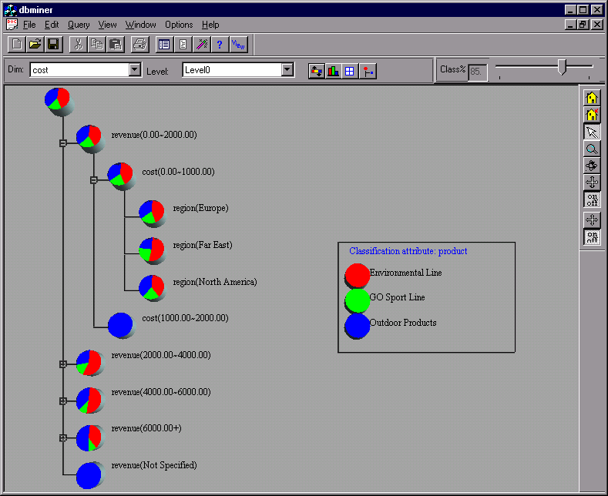
Presentation of Classification Results

Slide 32
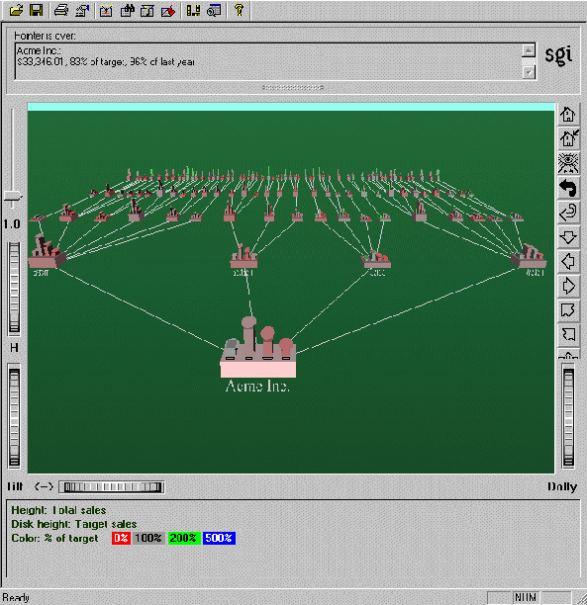
Visualization of a Decision Tree in SGI/MineSet 3.0

Slide 33
Thanks！
Notes:
工作新意图发现

